Slide 1
Project Demo
Website Redesign
Notes:
Scott (introduce yourself and state your role)
Welcome to Demo of the WL website redesign
We are Team Rocket

Slide 2
Team Roles & Responsibilities
Project Manager Cameron Abell | Responsibilities - Initiate - Plan - Execute - Control - Close
Development Team Alex Schoborg, Michael Ly, Caleb Caster, and Chancellor Caldwell | - Research - Design - Implement
Testing Team Brian Lam and Scott Luong | - Test - Fix
Team Rocket
Notes:
Scott
Our project manager is Cameron
Dev team consists of Alex, Michael, Caleb, and Chance
Test team consists of Brian and Scott

Slide 3
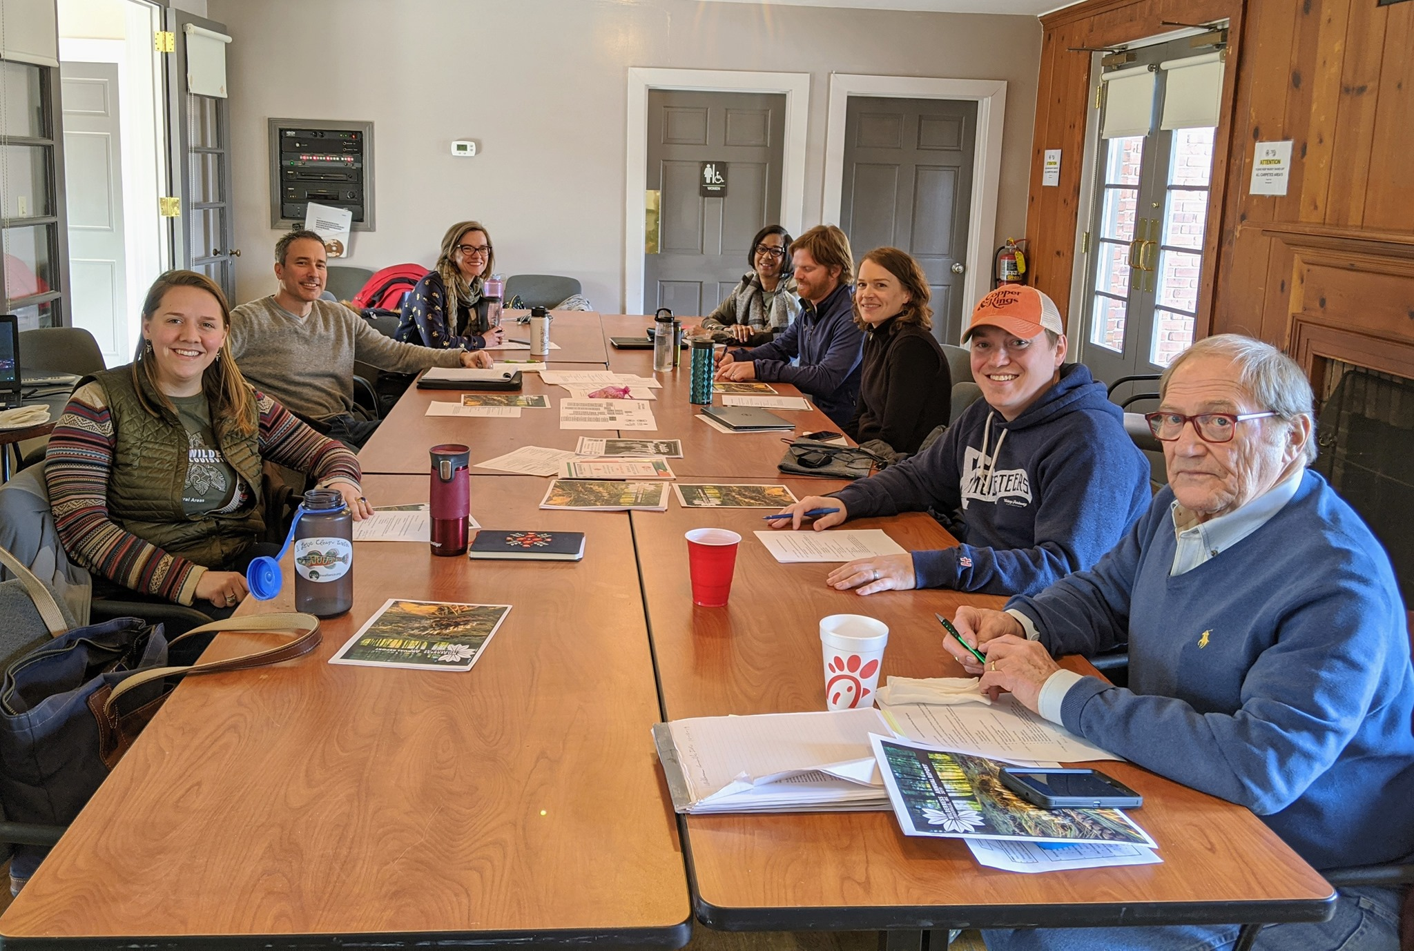
About Wilderness Louisville
Mission Statement
“We are champions for Louisville’s natural areas from Jefferson Memorial Forest, the nation’s largest city-owned urban forest, to the ones in your neighborhood.”
Who They Are
Wilderness Louisville is a nonprofit who works in partnership with the Louisville’s Department of Parks and Recreation to promote the development, stewardship and community awareness of these important public spaces.
Key Initiatives
ECHO focuses on providing youth and families with equitable access to nature by seeking to create opportunities.
The West Louisville Outdoor Recreation Initiative (WLORI) is Louisville Parks and Recreation’s drive to increase equitable access to nature for Louisville children and families.
Notes:
Scott
Wilderness Louisville is a nonprofit who works with Louisville’s Metro Government to promote the development, stewardship and community awareness of Louisville’s natural areas including Jefferson Memorial Forest.
The mission statement and a couple of the key initiatives in which they are involved in are listed here.
Mike is up next to talk about the project and scope

Slide 4
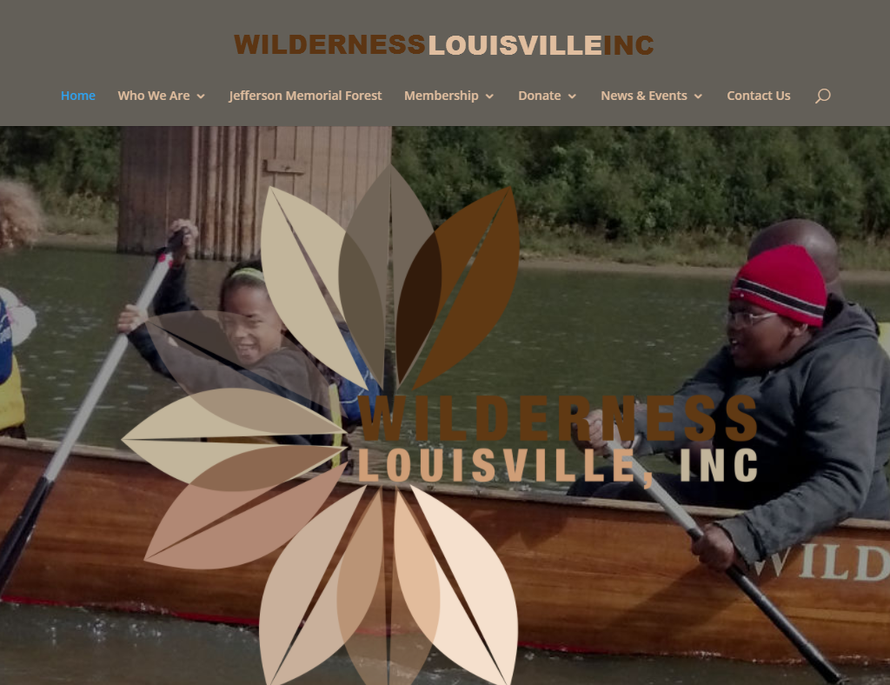
Project Purpose
Current website is:
Feels abandoned
Not very user friendly
Hard to find information
Doesn’t reflect what WL or JMF has to offer
Lacks the functionality WL wants
Notes:
Scott (introduce yourself and state your role)
Wilderness Louisville’s website contains outdated content that was posted years ago, navigation links that aren’t up to standards, and an interface that is not very user friendly.
Overall, the current website does not reflect everything Wilderness Louisville has to offer and lacks much of the functionality they need.
As a result, UofL has offered to help redesign and build a new website for Wilderness Louisville.

Slide 5
Planning Phase
Notes:
Mike
This brings us to the planning phase

Slide 6
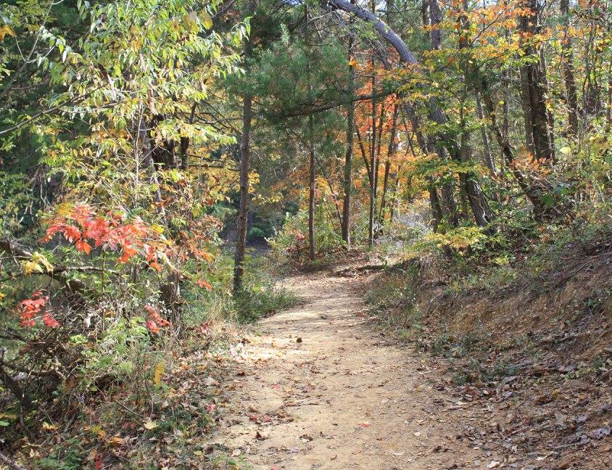
Project Summary & Scope
Redesign and development of a mobile-friendly website for Wilderness Louisville where users can easily find the content they are looking for and feel confident in their donations.
Project Scope
Host and Domain Setup
WordPress Installation and Setup
Theme Design and Development
Site Navigation Setup
Content Entry
Features as labeled in the Business Rules
Web and Mobile Browser Testing
Notes:
Mike
Our goal for the project is to completely redesign and develop a new mobile-friendly website for Wilderness Louisville that contains all the functionality they want, is user friendly, and looks great!
To do this, we have defined our project scope to include [only list a few]

Slide 7
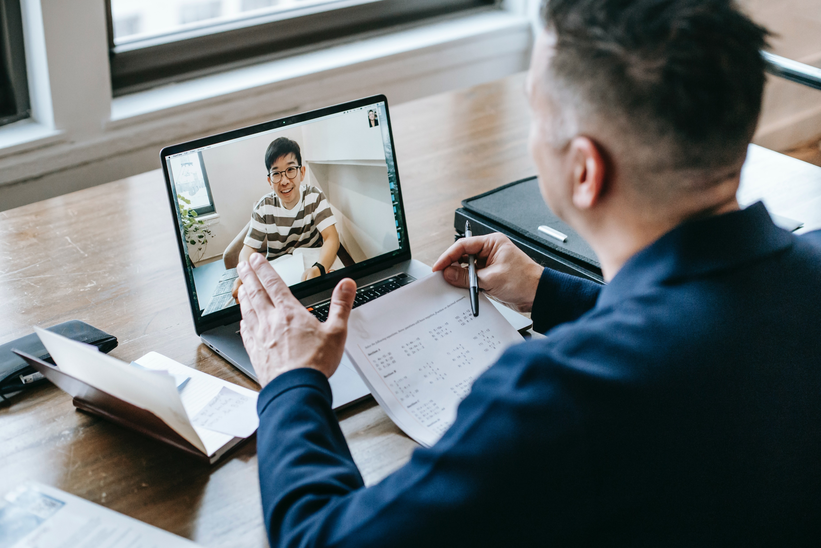
Obtaining the Business Rules
Last semester’s CIS 320 Strategic Assessment
Identified areas with potential for improvement​
Quantified the benefits of a site redesign
We also worked closely with the client, presenting our findings and getting feedback on:​
General Planning
Collection of Required Data​
Development of Use Cases
Requests made by the client​
Through this back and forth with the client, we developed business rules that reflect their expectations for the site.​
Notes:
Mike
The project was first started in our previous semester’s CIS 320 class, where we completed a Strategic Assessment
We also worked closely with WL to get feedback on our assessment and use cases while making notes of any requests.
Through all of this, we developed a list of business rules to reflect their expectations for the redesign
Alex is next to go over these business rules

Slide 8
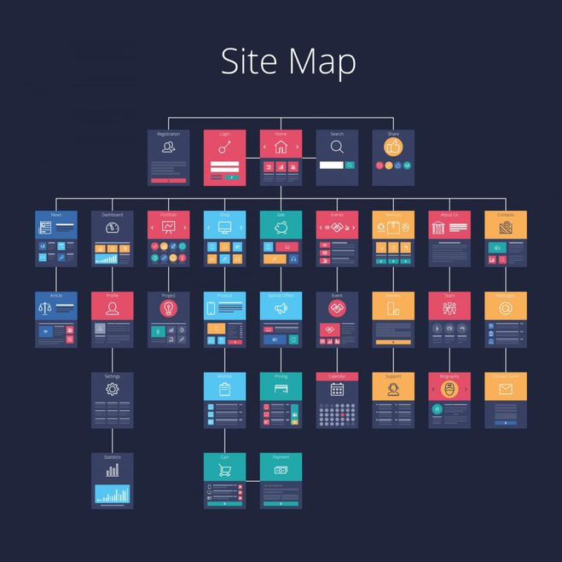
Business Rules - Operation Navigation
Top 5 Menu Items:
Additional Links for:
Hit the trails Choose Your Adventure Programs/Events | Key Initiatives Get Involved
Natural Areas About Us Calendar News | Blog Contact Careers | Login Donate Membership
Notes:
Alex (introduce yourself and state your role)

Slide 9
Business Rules - Operation Functionality
Interactive map of each park
Gives Directions
Is downloadable
Highlights:
Points of interest (campgrounds, trails, facilities, etc.)
Individual areas (Tom Wallace, Paul Yost, Horine, etc.)
eCommerce System
Supports refunds
Shows program/campsite availability
Customizable forms for gathering information from users
Automatic emailing capabilities
Functionality for donations, memberships, and merchandise store
Notes:
Alex
…

Slide 10
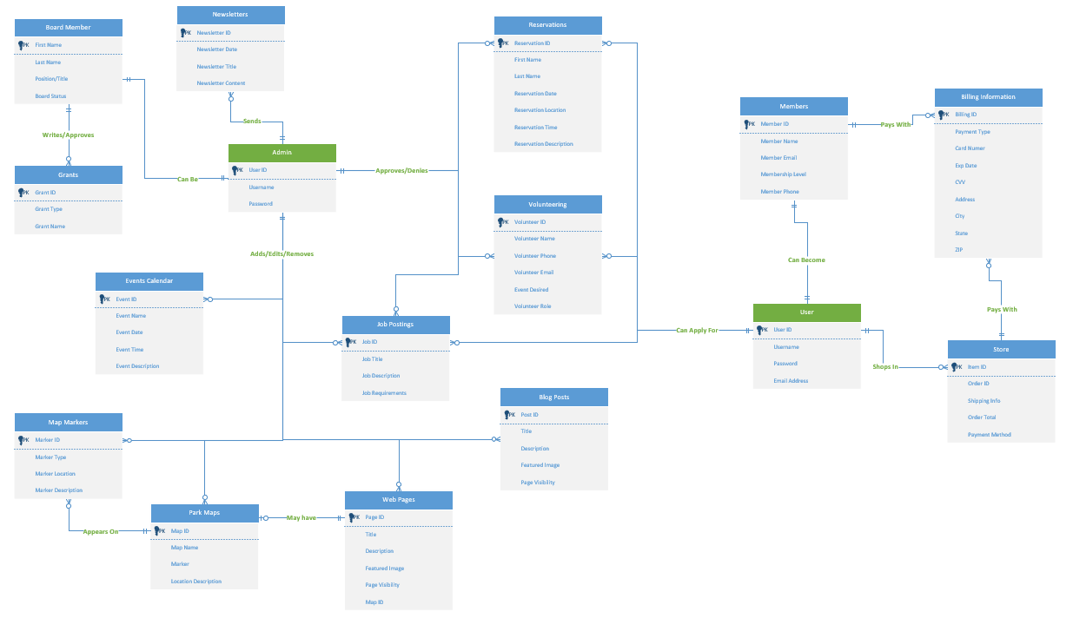
Business Rules - Operation Functionality
Additional functionality for
Calendar of Events
News/Blog
Newsletter Signup
Job Postings
Volunteering
Social Media Sharing
Notes:
Alex
…
Brian is next with the technology we are using and with our wireframes to prototypes phases

Slide 11
Technology Used
Name of Technology Microsoft Azure DevOps Adobe XD Namecheap Custom Linux Server (Dell Inspiron Desktop) PHPmyAdmin WordPress WordPress Plugins Avada WP Google Maps Simple Weather WooCommerce The Events Calendar FileBird Pods FacetWP | Purpose Project Management Tool Wireframing and Prototyping Tool Domain Registration Website Hosting Easy Database Management Base Platform Template and Builder Framework Interactive Maps for Parks Live Weather Updates ECommerce Toolkit Advanced Calendar Media Files Organizer Framework to Create Custom Post Types, Taxonomies, & Fields Advanced Filtering Tool
Notes:
Alex (introduce yourself and state your role)
The technology we’ve used and plan to use includes:
List each technology and purpose
After gathering our rules, list of technology, and other additional plans, we entered the design phase

Slide 12
Design Phase
Notes:
Brian

Slide 13
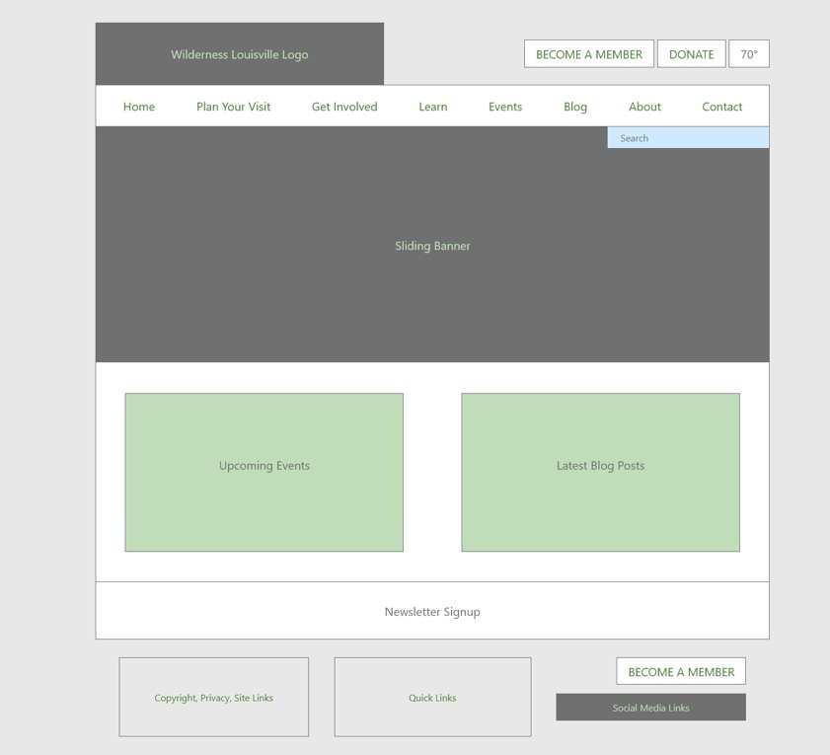
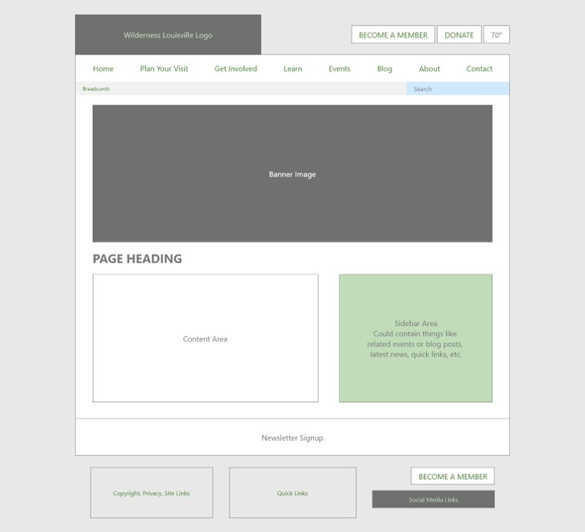
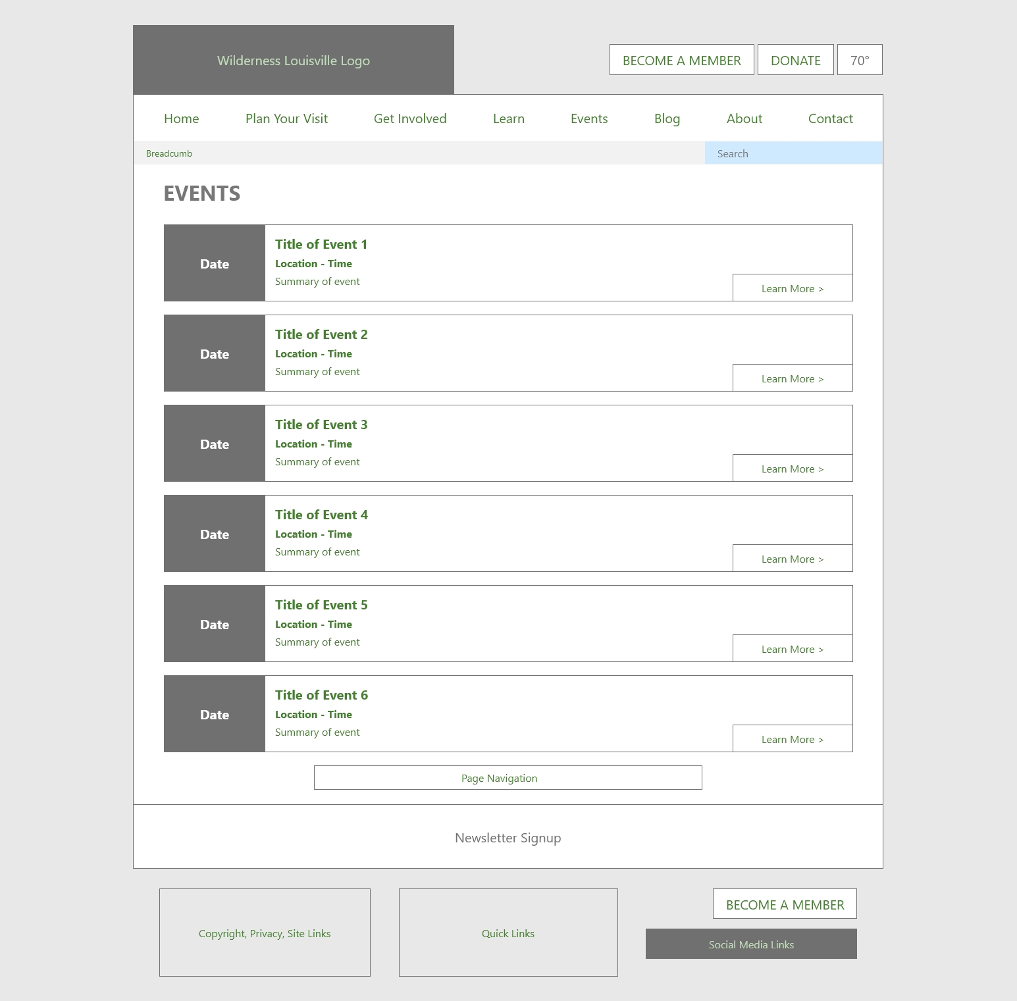
Landing Page
Info Page
Events Page
Wireframes
Notes:
Brian
Here are some examples of the wireframes we made during the early stages of our design process. The goal for these was to get the general layout of the site website established.

Slide 14
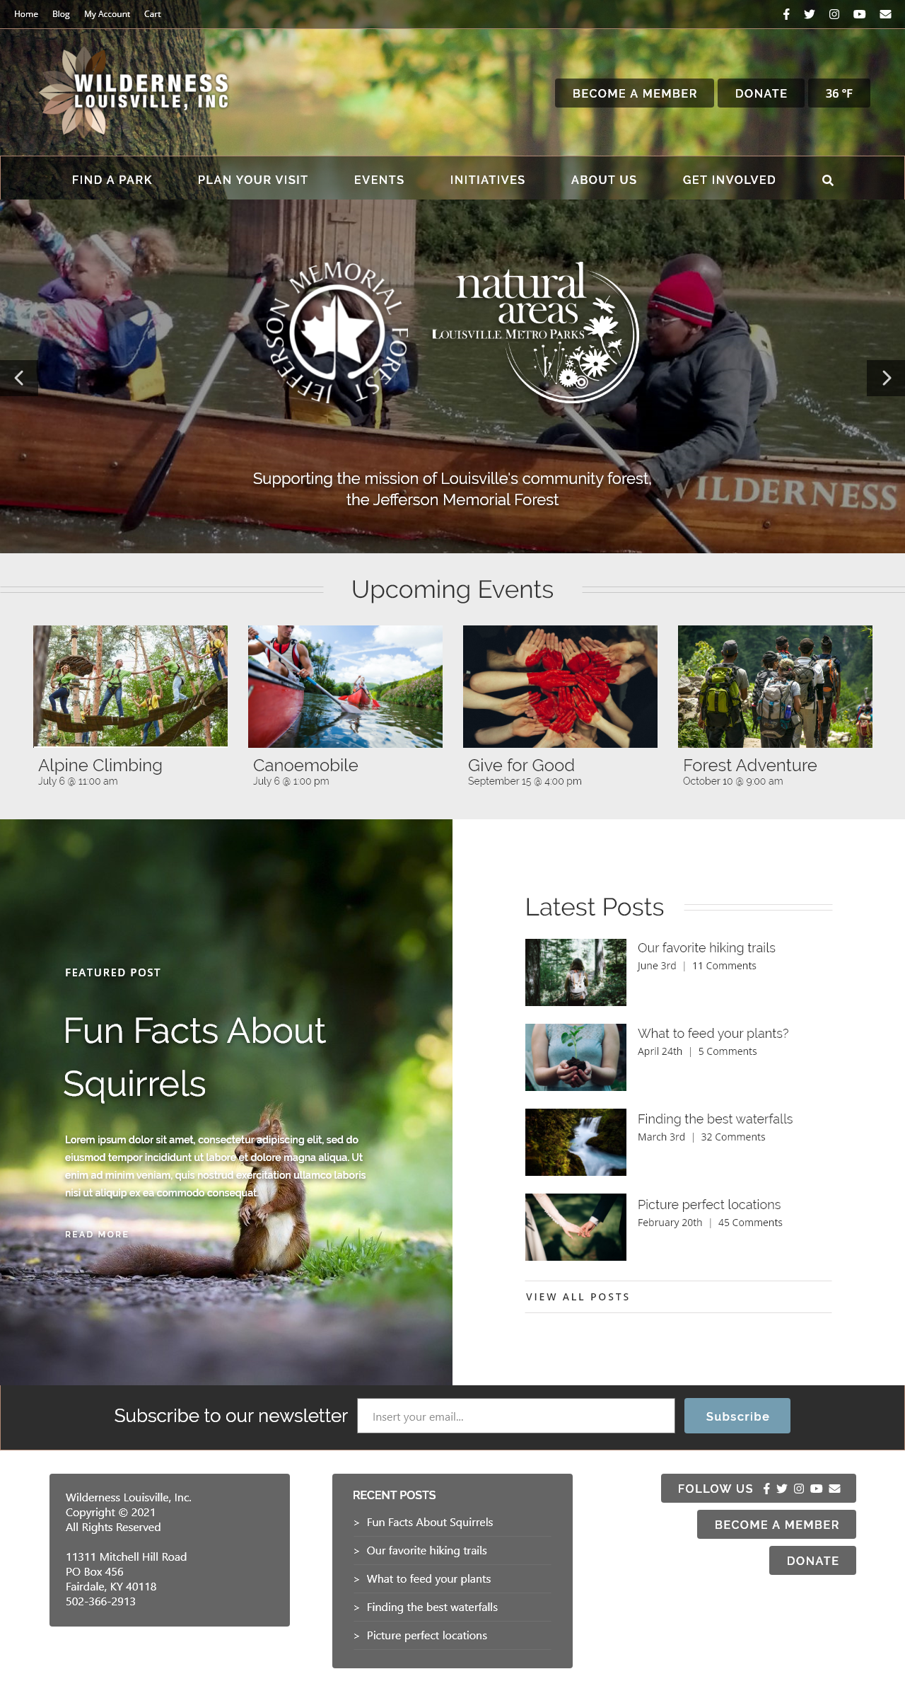
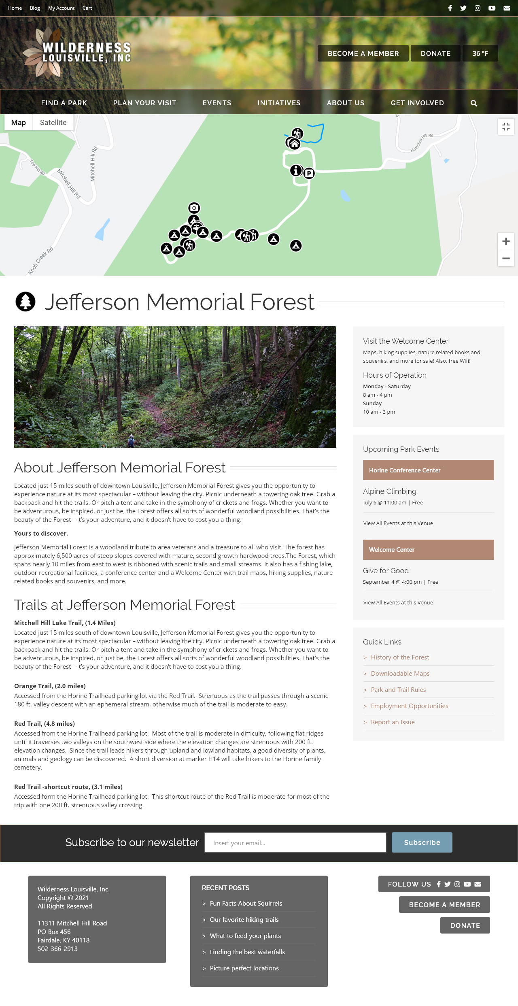
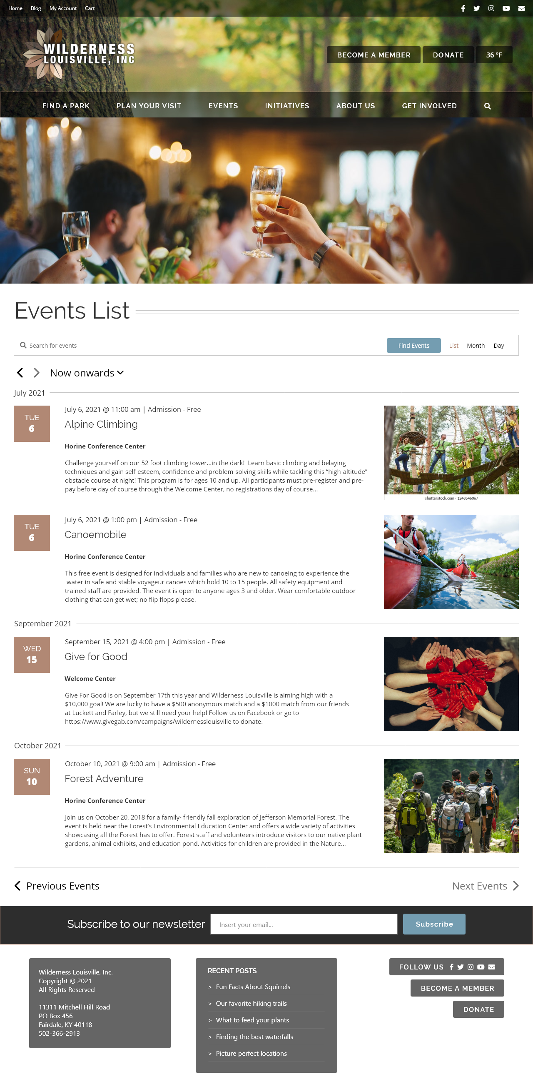
Landing Page
Park Page
Events Page
Prototypes
Notes:
Brian
After finishing the wireframes, we created prototypes to show the design in detail of how we wanted it to look.
Once completed with the prototypes, we entered the development phase where we’ve spent the past month building the website.

Slide 15
Development Phase
Notes:
Chance

Slide 16
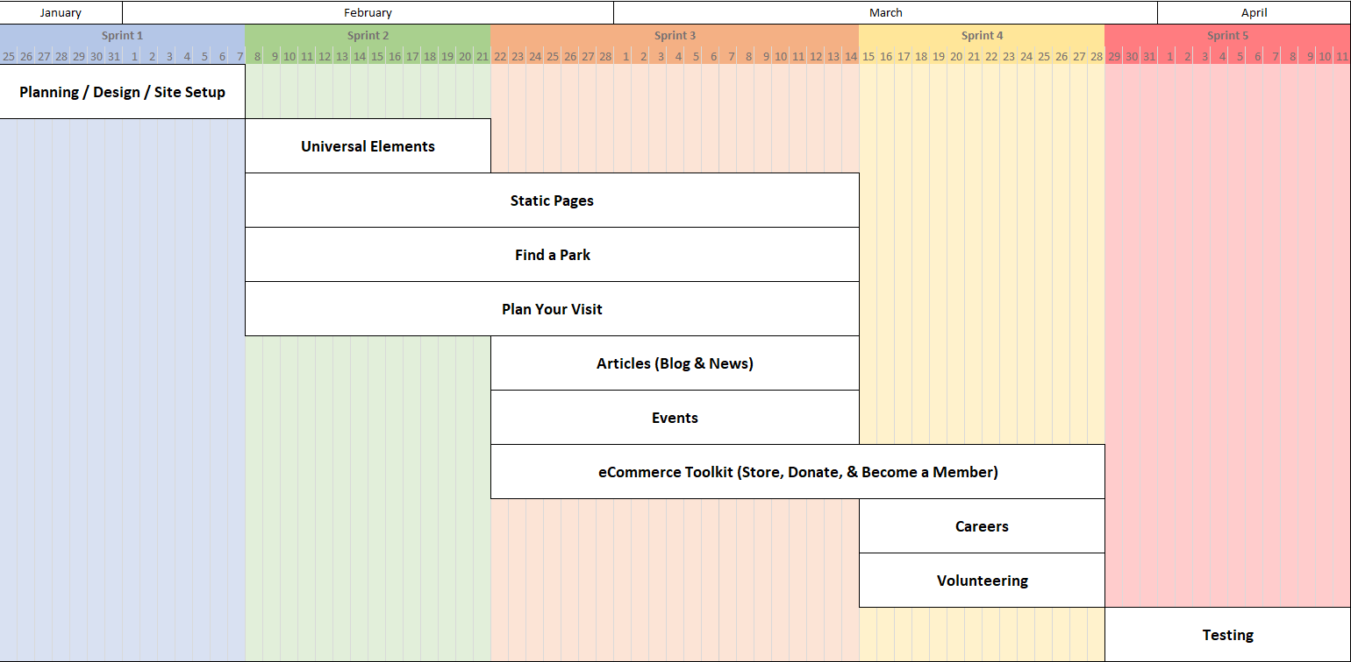
Roadmap
Notes:
Michael
This is the project’s roadmap, showing everything that took place during our development phase.
Starting in January, we split the project up into 5 sprint or iterative periods of about 2 weeks each.
At the beginning of each sprint, we gave ourselves goals to accomplish and each signed up for work to do relating to those goals.
Development finished toward the end of March, where we began testing the website in April during Sprint 5.

Slide 17
Testing Phase
Notes:
Chance

Slide 18
Testing & Results
Units Tested Regular & mobile browsers including: Microsoft Edge Google Chrome Apple Safari Resolutions Tested Older Smartphones (320x568) Newer Smartphones (375x812) Older Tablets (768x1024) Newer Tablets (1024x1366) Full HD Monitors (1920x1080) 4K Monitors (3840x2160) | Users Tested # Adults Ages #-# # Adults Ages #-# # Adults Ages #-# # Teens Ages #-# Feedback …
Notes:
Chance
Unit testing has been going great so far with the website being tested on a variety of devices including desktops, laptops, tablets, and smartphones of all different brands and screen resolutions, some of which are listed here.
Our user and usability testing is still ongoing, and we plan to have numbers and feedback to show here in the final demo.
Now that we’ve covered the whole process of the project, I’m going to pass it off to Caleb to start off the live demo.

Slide 19
Live Demo
Notes:
Caleb

Slide 20
Landing Page
Showing at the top of every page
Main and secondary navigation
Day of week and Jefferson Memorial Forest’s current weather updating every 5 minutes
calls to action for donating and becoming a member
Social media links
A slider for showing featured content, events, or anything you want users to first see when entering the site (Currently it shows WL’s mission, Initiatives, and featured event)

Slide 21
Landing Page
Page also contains widgets showing upcoming events and the latest posts
At the bottom of every page, we have the newsletter signup, copyright and contact information, an area to display widgets like recent posts, and the call to actions like we saw at the top of the page

Slide 22
Main Navigation
The main navigation includes pages to:
All the parks
Activities offered
Events and facility rentals
Key initiatives
About Us
And Get Involved where you can find pages for volunteering and careers

Slide 23
Each Park Page
Contains an interactive map of the park showing points of interest like campgrounds, trailheads, or restrooms as well as drawings of each trail
You can even get directions to any of these points
The rest of the page contains information about the park, hours of operation, park resources, and upcoming events at the park

Slide 24
Adventure Pages
Make it easy to find information on activities offered at each park
For example, the Hiking page allows you to filter through all the different hiking trails Wilderness Louisville offers, narrowing down by:
Parks
Trail difficulty
Distance or duration
Nearby amenities
Or things you will see along the trail
The page also has links for additional resource related to the activity as well as upcoming events containing that activity

Slide 25
Events
can be searched and viewed by either a list, calendar or day.
In list view, you can easily see a description, date and time, location, as well as the price of each event very quickly
Events can be clicked on for additional details like saving it to your calendar, getting directions, or finding contact information of the event organizers
Users can also click on an event to RSVP or purchase event tickets to any premium events

Slide 26
Facility & Campsite Rentals
Users can rent facilities like shelters or venues as well as campsite. Campsite rentals can also be accessed from the Camping activity page
To book or rent, simply choose which one you want, pick a check-in and check-out date for the number of days you want to book for, check to see if it is available, book, and checkout
One of the cool things with this is that as a staff member, you can add coupons, a variety of different tax rates and fees, additional services that are optional to the user at checkout (like Firewood), as well as set things like capacity, seasonal rates, or blackout dates.

Slide 27
Articles
The Article page contains all the latest news and blog posts. This was put in the secondary header since it is already display on the landing page
Notes:
Caleb
Now I’m going to pass it off to Cameron

Slide 28
Store
Store contains any merchandise or products you’d like to sell, offering advanced functionality like creating sales, coupons, tracking inventory, up-selling or cross-selling, marketing, adding tax, multiple shipping options, and much more
Users that have purchased also can leave reviews

Slide 29
Donate
Donate page talks about how a donation could have an impact on helping our community
Right contains the donation form, showing a current campaign goal with the progress so far
Below that, users can see recent donors and their comments, reassuring the user that they are donating to a great cause. Upcoming donor events can also be found below that.
Users can continue through the form, choosing a pre-defined or custom amount, and filling out their contact and payment information
Donations are tracked within the backend through an incredibly robust donation system that tracks campaign performance, average donation amount, top donors, as well as a variety of other stats and reports
The system also offers connectivity with Bloomerang, syncing collected donor information with the system WL already uses

Slide 30
Become a Member
The become a member page is also setup very similarly, showing the membership tiers and a signup form on the right with newest members at the bottom
We could also add Member only events to the bottom of this page if desired

Slide 31
Account
Account page displays all their account information, orders, downloads, or event tickets that have been purchased, as well as the donation history of the user

Slide 32
Volunteer & Careers
Lastly we have the volunteer and career pages. Also setup similarly, we show information about volunteering, the requirements, upcoming volunteering opportunities, links to the signup and login portals, as well as list other commitment-free, group, and scouts opportunities

Slide 33
A Quick Look at the backend
Go through the menu items

Slide 34
Skipping Initiatives, About Us and Contact Us
Unfortunately, we do not have time to show all the other wonderful features or beautiful pages due to the limited time, but if you were to do more exploring after, I guarantee that you will not be disappointed!

Slide 35
One last thing
The website is completely responsive to all types of browsers, meaning it works perfect on smartphones, tablets, laptops, and desktops!

Slide 36
Introduced to the team and client Covered the 4 phases of the project Went into a live demo showing:
Recap
Landing page
Natural Areas
Adventures
Events
Facility and Campsite Bookings/Rentals
Articles containing the News and Blog
Merch Store
Donate and Become a Member
Volunteer and Careers
Quick look at the backend
Notes:
Cameron
Landing page with slider, upcoming evens and recent posts
Park pages containing interactive maps
Offered activities with ability to search and find what each park has to offer
Events listings and calendar with ticketing and RSVP functionality
Facility and Campsite Bookings/Rentals
News and Blog contained within Articles
Store where users can purchase merch
Donation and Become a Member pages
Volunteer and Career pages

Slide 37
Any Questions?
Notes:
Cameron

Slide 38
Any Questions?
Notes:
Cameron

